Slide 1
Advanced UNIX Shell Commands
Lab No. 2
Operating Systems Lab
Focus: Commands, Examples & Diagrams
Objectives:
To know the UNIX shell, special characters and commands.
To describe Unix commands.

Slide 2
grep Command:
Purpose: Search text patterns
g/re/p [globally search a regular expression and print]
grep --help
grep <someText> <fileName>
use -i for case insensitive search

Slide 3
With regular expressions:
grep -E ^<text> <fileName>
grep -E <0-4> <fileName>
grep –E <a-zA-Z> <fileName>

Slide 4
Grep <word> <filename>
grep <word> file1 file2 file3
grep text *
grep -x apple fruitlist.txt
grep --color < word> <filename>
grep ^p fruitlist.txt
grep -v apple fruitlist.txt

Slide 5
sort Command
Command: prints the lines of its input or concatenation of all files listed in its argument list in sorted order
sort names.txt
Options:
-n Numeric sort
-r Reverse sort

Slide 6
Examples:
sort <any number of filenames> #sort the content of file(s)
sort <fileName> #sort alphabetically
sort -o <file> <outputFile> #write result to a file
sort -r <fileName> #sort in reverse order
sort -n <fileName> #sort numbers

Slide 7
wc Command (word count)
Command: wc file.txt
Output: Lines Words Characters
$wc <fileName>
Arguments includes: -l (lines)
-w (words)
-c (byte size)
$ wc * : counts for all files in the current directory.

Slide 8
cut Command
cut is a data filter: it extracts columns from tabular data.
cut –c 1 record.txt # -c specifies characters to be extracted
cut –c 1,4,7 record.txt #characters 1, 4, and 7
cut -c1-3,8 record.txt #characters 1 thru 3, and 8
cut -c3- record.txt #characters 3 thru last
cut –f 1,4,7 record.txt #-f specifies fields to be extracted.

Slide 9
sed Command (stream editor)
sed stands for Stream Editor
Used to perform basic text transformations
Works on:
Files
Output of other commands (via pipes)
Processes input line by line
Very efficient for large files

Slide 10
Features of sed:
Performs editing in single pass
Supports:
Search & replace
Delete lines
Insert and append text
Print selected lines
Works with regular expressions

Slide 11
sed –e 's/input/output/' my_file
sed –e 's/input/output/g' my_file # g stands for global
sed –e 's/input/output/' my_file > new_file # redirect output to file
sed -i –e 's/input/output/' my_file #edit the existing file in place you should use the -i flag
sed –e 's/[0-9]*/(&)/' my_file #'&' corresponds to the pattern found.

Slide 12
Command | Meaning
s | Substitute
d | Delete
p | Print
i | Insert
a | Append
-n | Suppress default output
-i | Edit file in-place

Slide 13
tr (translate)
The tr filter is used to translate one set of characters from the standard inputs to an- other.
tr ‘a-z’ ‘A-Z’ < example.txt
tr 'abcd' 'jkmn’

Slide 14
Process management commands :
Ps :process status
$ ps
PID TTY TIME CMD

Slide 15
kill Command – Example
Kill : Forcefully terminates process
kill -9 PID
kill 1234
kill -s TERM 1234 kill -TERM 1234
kill -15 1234
The process can be sent a SIGKILL signal in three ways:
kill -s KILL 1234
kill -KILL 1234
kill -9 1234

Slide 16
chmod – Example
Numeric Mode:
chmod 755 file.sh
Symbolic Mode:
chmod u+x file.sh

Slide 17
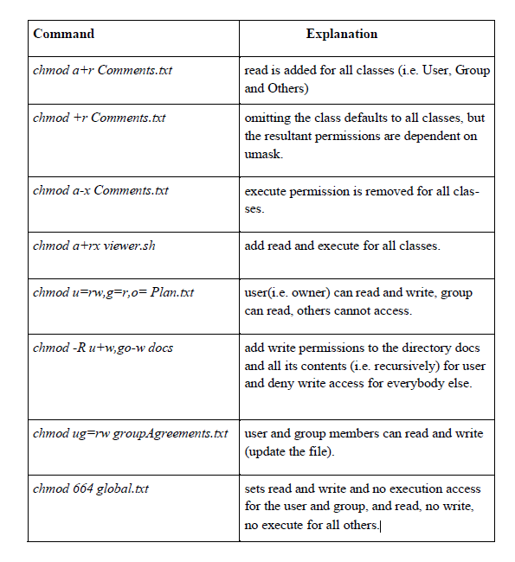

Slide 18
Other useful commands
1. echo
2. bc
Example:
bc (press enter) 3+2
bc –l # for floating point answer
bc 3>2

Slide 19
vi Editor
Command Mode
Insert Mode
Last Line Mode

Slide 20
vi Commands – Example
:w Save
:q Quit
:wq Save & Quit

Slide 21
Summary
✔ Text Processing
✔ Process Management
✔ File Permissions
✔ Hands-on Practice

